Slide 1
Adversarial Distillation
Natan.katz@gmail.com

Slide 2
Contents
What is distillation?
MCMC and why we wish to distill it
BNN
Generative Models
GAN –From foundation to Wasserstein
ADP

Slide 3
Knowledge Distillation
What is it?
Distillation- Given a complex model , we wish to train a significantly simpler model to have its “knowledge”
A common use case
Assume that we wish to use GoogleNet in our own mobile
Distillation differs from transfer learning since we reduce the complexity and not copy the model’s weights

Slide 4
Distillation –Terminology
Teacher model\cumbersome model – The big model that knows”
Student\distilled model – The small model that is trained

Slide 5
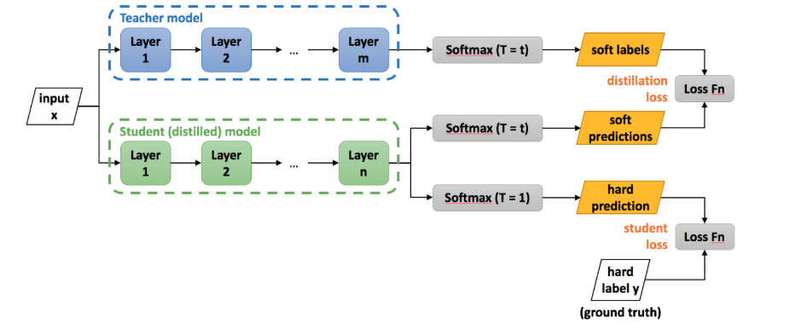

Slide 6
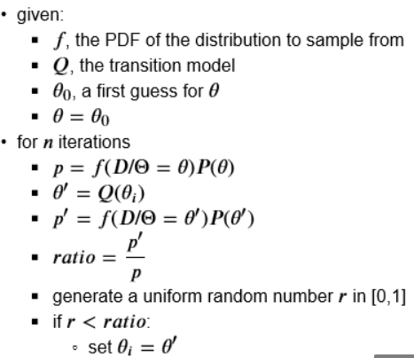
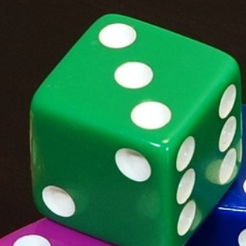
MCMC
MH Algorithm
A class of sampling algorithms
Used often to find posterior distribution

Slide 7
Distillation for MCMC Algorithms
Why is it needed?
MCMC is slow
MCMC iterates many times over the entire data
Massive calculations (accept-reject)
Tedious …

Slide 8
Distillation for MCMC Algorithms
What if?
We find a teacher- A model that knows to find posterior distribution
We find a skilled student- Some one that knows to generate
They may work well together
Let’s do it!

Slide 9
Uncertainty
Bayesian inference commonly outputs a confidence estimation in addition to prediction score.
What about DL and confidence….?
Not too much … ☹

Slide 10
Uncertainty Types
Epistemic Uncertainty :
Episteme= Knowledge
Uncertainty that theoretically we can remove:
Model is incorrect
Absence of data
We can use the notion “reducible” too

Slide 11
Uncertainty Types
Aleatoric Uncertainty :
Aleator = Dice Player
Uncertainty that we cannot solve:
The stochasity of a dice
Noisy data
The notion “irreducible” uncertainty is often used

Slide 12
DL & Uncertainty
DL Framework
DL focuses mainly on prediction
We hardly ever ask questions such as
“Are the weights correct?”
“What should be the weights’ distribution?”
DL focuses on training deterministic functions
Is uncertainty important ?
Images of dogs and cats are nice anecdote……
What about MRI? Melanoma?

Slide 13
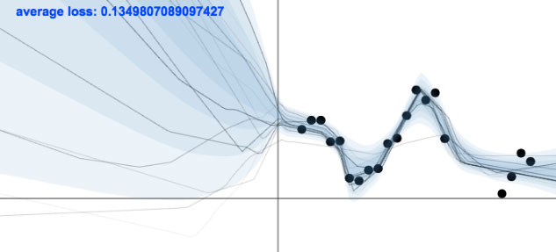

Slide 14
BNN & Uncertainty
2015 Yarin Gal
Uncertainty modelling can be studied using BNN

Slide 15

BNN
We have a neural network with weight W
We place a prior distribution over the weights
We have data (X,Y)
We study the posterior Distribution

Slide 16
DL Vs. BNN
DL
Loss is prediction driven P(Y|X,W)
Study weights W point-wise
Bayesian NN
Loss is posterior driven P(W|X,Y)
Study weights distribution (prior assumption is given)

Slide 17
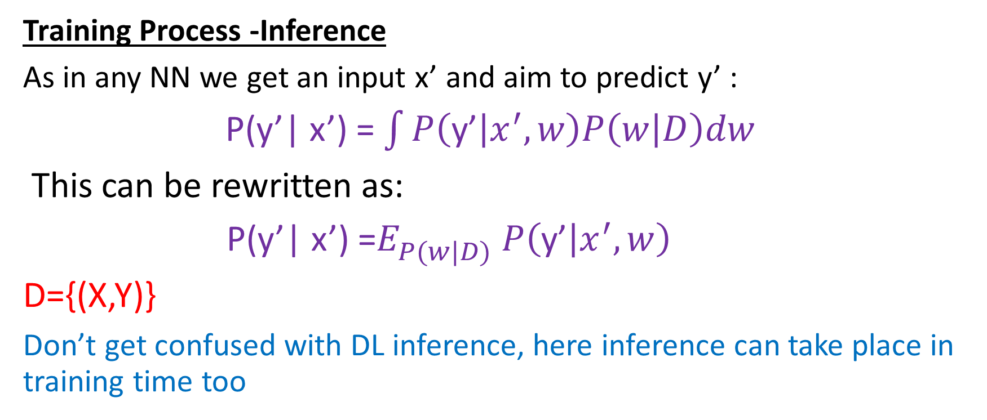
BNN-Inference
Training Process -Inference
As in any NN we get an input x’ and aim to predict y’ :
P(y’| x’) = $\int{P\left(\text{y}\text{’} | x^{′},w\right)P\left(w | D\right)dw}$
This can be rewritten as:
P(y’| x’) =$E_{P(w|D)}^{ }$ $P\left(\text{y}\text{’} | x^{′},w\right)$
D={(X,Y)}
Don’t get confused with DL inference, here inference can take place in training time too

Slide 18
Common tools to solve the integral
MCMC –Sampling (Metropolis –Hastings, Gibbs)
Variational Inference
HMC
SGLD

Slide 19
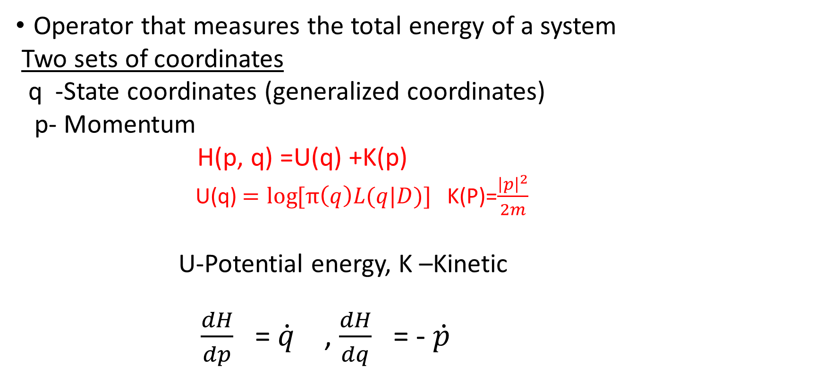
What is Hamiltonian?
Operator that measures the total energy of a system
Two sets of coordinates
q -State coordinates (generalized coordinates)
p- Momentum
H(p, q) =U(q) +K(p)
U(q) $=log{[π\left(q\right)L(q|D)}]$ K(P)=$\frac{{\left|p\right|}^{2}}{2m}$
U-Potential energy, K –Kinetic
$\frac{dH}{dp}$ = $\dot{q}$ , $\frac{dH}{dq}$ = - $\dot{p}$

Slide 20
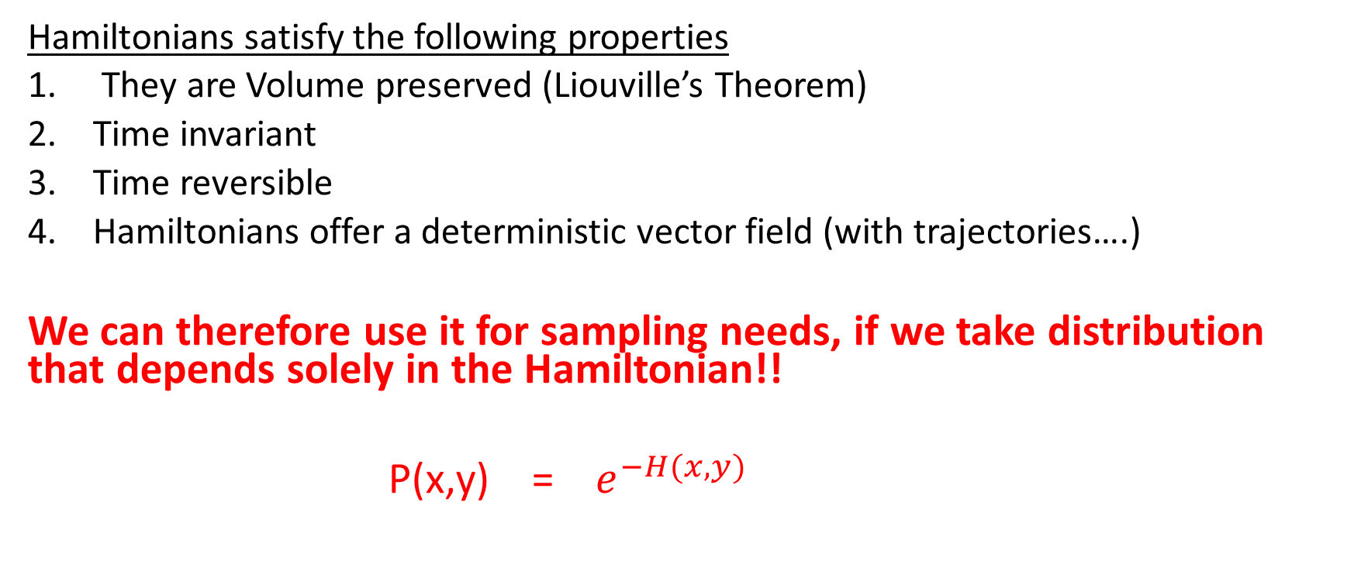
Hamiltonian Monte Carlo
Hamiltonians satisfy the following properties
They are Volume preserved (Liouville’s Theorem)
Time invariant
Time reversible
Hamiltonians offer a deterministic vector field (with trajectories….)
We can therefore use it for sampling needs, if we take distribution that depends solely in the Hamiltonian!!
P(x,y) = $e^{−H(x,y)}$

Slide 21
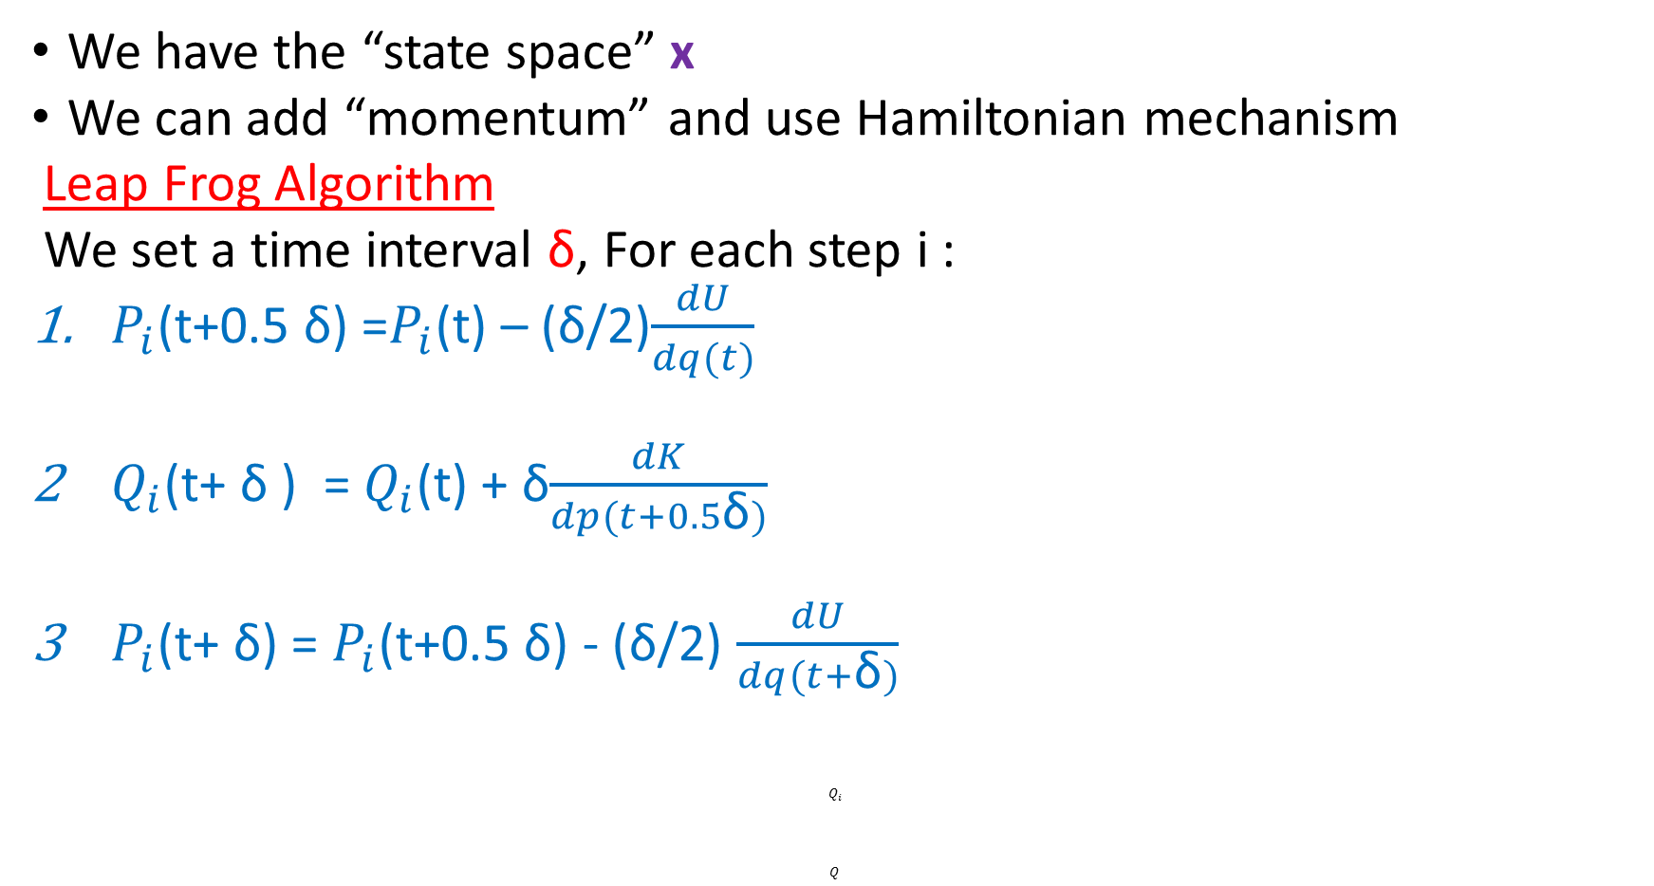
Hybrid - MC
We have the “state space” x
We can add “momentum” and use Hamiltonian mechanism
Leap Frog Algorithm
We set a time interval δ, For each step i :
$P_{i}$(t+0.5 δ) =$P_{i}$(t) – (δ/2)$\frac{dU}{dq(t)}$
$Q_{i}$(t+ δ ) = $Q_{i}$(t) + δ$\frac{dK}{dp(t+0.5\text{δ})}$
$P_{i}$(t+ δ) = $P_{i}$(t+0.5 δ) - (δ/2) $\frac{dU}{dq(t+\text{δ})}$
$$Q_{i}$$
$$Q$$

Slide 22
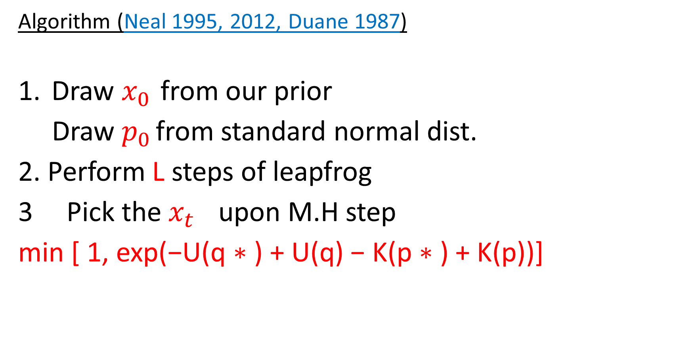
HMC
Algorithm (Neal 1995, 2012, Duane 1987)
Draw $x_{0 }$from our prior
Draw $p_{0 }$from standard normal dist.
2. Perform L steps of leapfrog
Pick the $x_{t }$ upon M.H step
min [ 1, exp(−U(q ∗ ) + U(q) − K(p ∗ ) + K(p))]

Slide 23
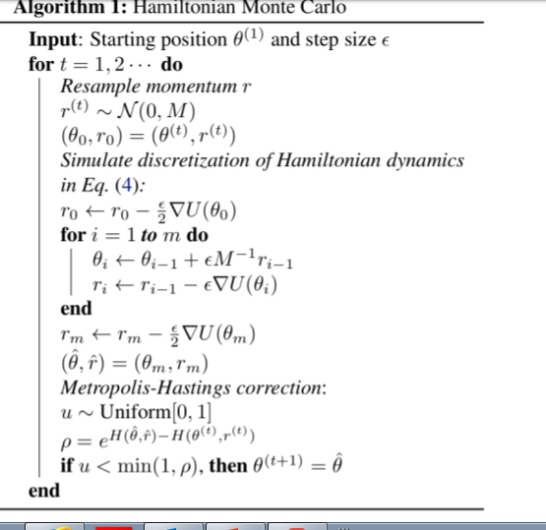

Slide 24
HMC –Pros & Cons
Pros
It takes points from a wider domains therefore we can describe the
distribution better and converges faster
It may take points with lower density
Faster than MCMC
Ergodicity
Cons
It may suffer from low energy barrier
No minibatch
It has to calculate gradients for the entire data!!! Bad

Slide 25
What do we need then?
A tool that allows sub-sampling
Fewer Gradients
Keen knowledge about extremums and escape rooms

Slide 26
SGLD
A combination of two tools:
Stochastic approximation (Robbins & Monro)
Langevin Equation

Slide 27
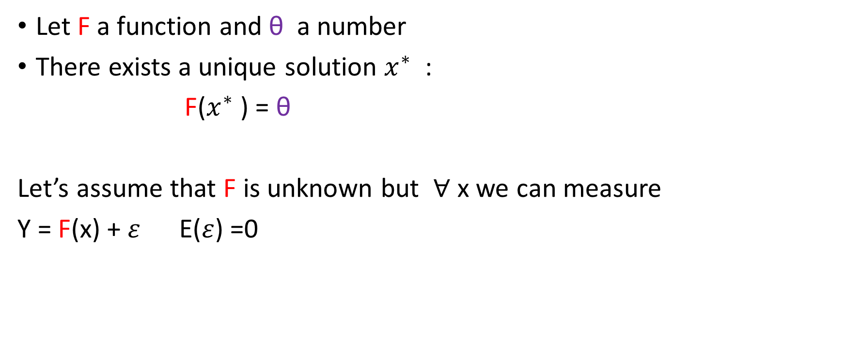
Robbins & Monro (Stoch. Optimization 1951)
Let F a function and θ a number
There exists a unique solution $x^{∗}$ :
F($x^{∗}$ ) = θ
Let’s assume that F is unknown but $∀$ x we can measure
Y = F(x) + $ε$ E($ε$) =0

Slide 28
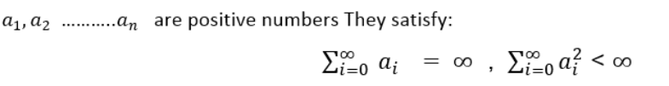
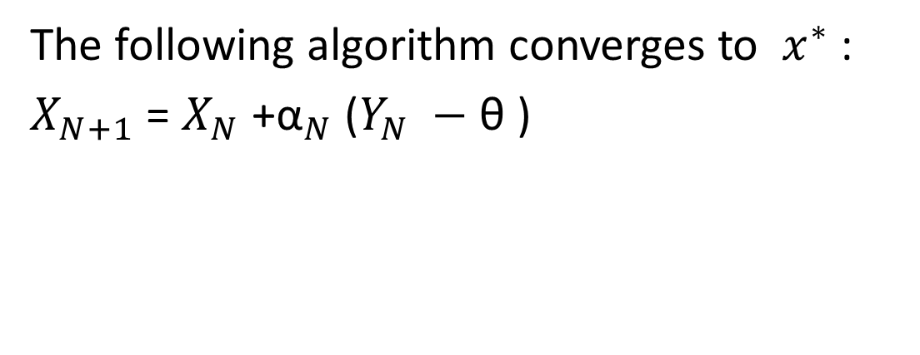
Robbins & Monro (cont)
The following algorithm converges to $x^{∗}$ :
$X_{N+1}$ = $X_{N}$ +${\text{α}}_{N}$ ($Y_{N} −$ θ )

Slide 29

Robbins & Monro in our Scenario
We can use mini-batches rather entire data
For posterior we get the form:

Slide 30
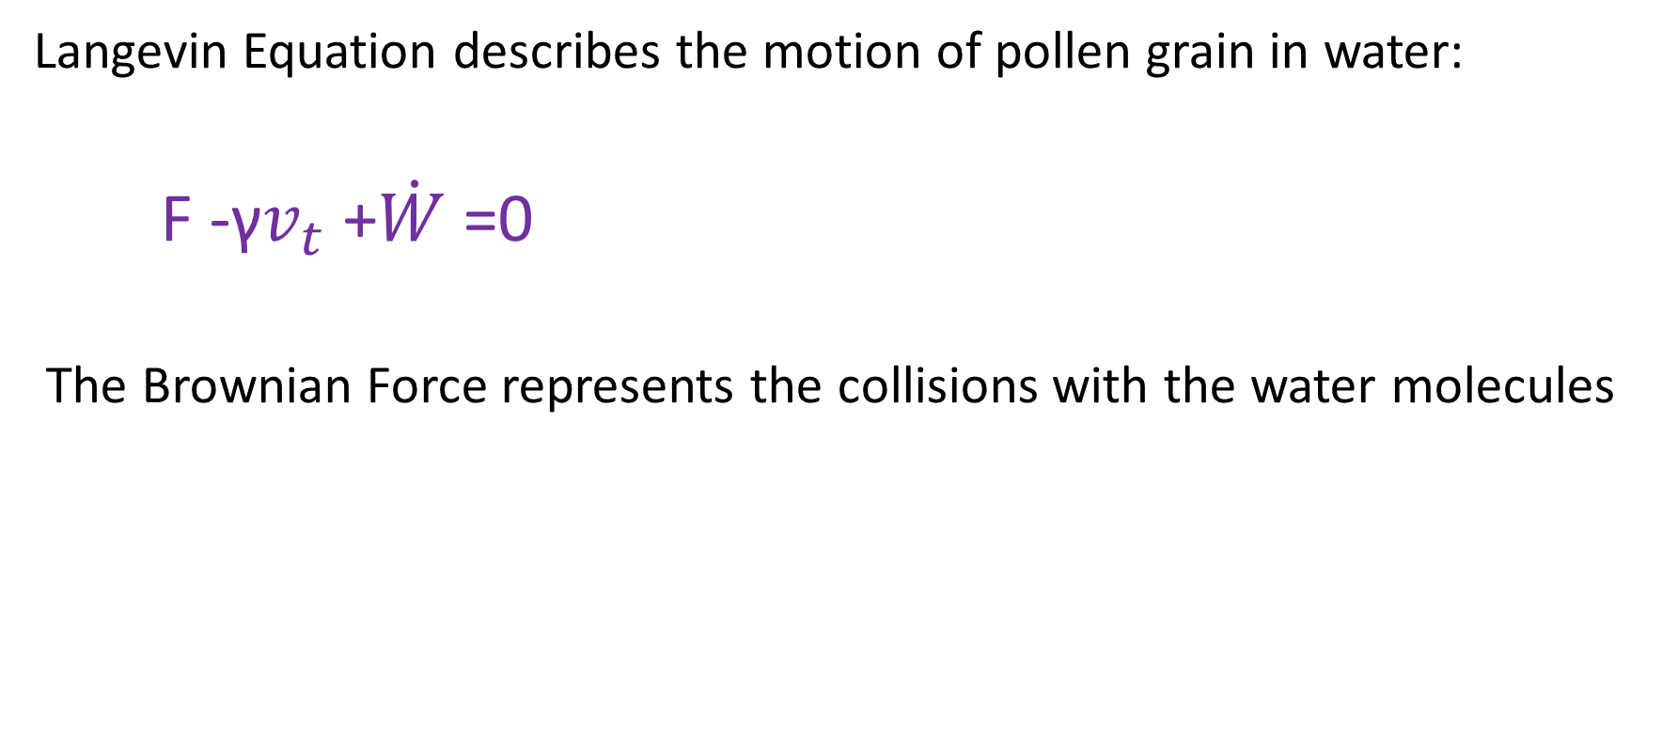
Langevin Equation
Langevin Equation describes the motion of pollen grain in water:
F -γ$v_{t}$ +$\dot{W}$=0
The Brownian Force represents the collisions with the water molecules

Slide 31
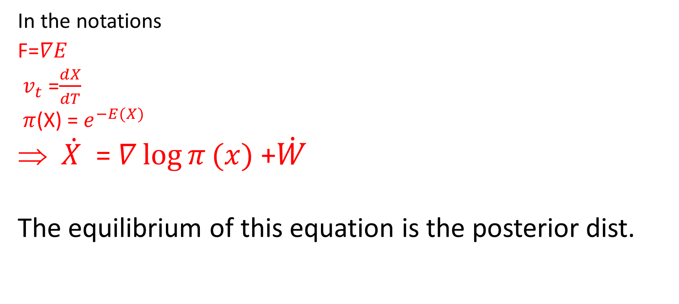
Langevin Equation
In the notations
F=$∇E$
${ v}_{t}$ =$\frac{dX}{dT}$
$π$(X) =$e^{−E(X)}$
$\dot{X}$ = $∇\log{π}(x)$ +$\dot{W}$
The equilibrium of this equation is the posterior dist.

Slide 32
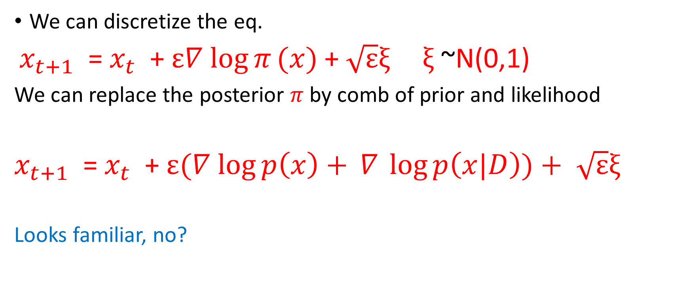
Langevin Eq.
We can discretize the eq.
$x_{t+1}$ = $x_{t}$ + $ε∇$ $\log{π}(x)$+ $\sqrt{ε}ξ_{ } ξ$ ~N(0,1)
We can replace the posterior $π$ by comb of prior and likelihood
$x_{t+1}$ = $x_{t}$ + $ε(∇$ $\log{p\left(x\right)+} ∇ \log{p\left(x|D\right))+}$ $\sqrt{ε}ξ_{ }$
Looks familiar, no?

Slide 33
What can we do
We have a tool that knows to find posterior
We have a tool that knows to preserve posterior
Let’s date both sisters

Slide 34
We add Robbins and Monro a stochastic noise
At the beginning R & M will take us to the domain of the Posterior.
When we will approach there the learning rate decays (following Robbins and Monro) and we will surround the posterior rather collapse there.

Slide 35


Slide 36
Wasserstein Gan

Slide 37
What is Generative Models? What it is not?
Discriminative models
We study the conditional distribution P(Y=c|X=x)
c-class, x-features vector
These models are trained for prediction tasks
Most of the DL renaissance occurred in this framework

Slide 38
Generative Model in Supervised Framework
Generative models Supervised
We construct the joint dis P(X,Y) using parameter estimations of
P(Y) ,and P(X|Y)
A common tool is Naïve Bayes

Slide 39
Generative Models (Cont)
Unsupervised
We don’t have target that guides us how to classify the data
We train a generating deterministic function
x= f(z,θ)
f –deterministic, z –hidden variable θ -parameters
We use MLE or ELBO as loss function.

Slide 40
What are Adversarial samples?
Adversarial are simply perturbed inputs that may cause NN to misclassify the data
They are often generated intentionally
They are located outside the data manifold (kind of noise)
Goodfellow -Explaining & Harnessing Adv. Ex.
He aimed to train DNN by introducing adversarial examples.
GAN was born

Slide 41
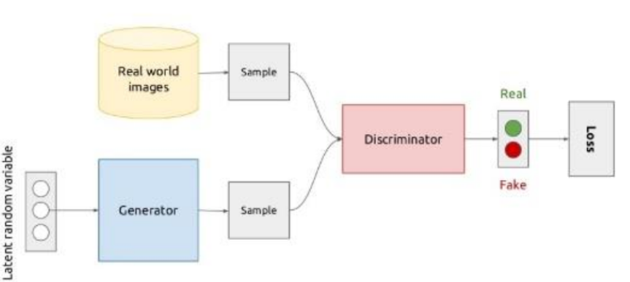

Slide 42
Goodfellow’s Network -GAN
Discriminator
A Common neural net (DNN\CNN )
Input: Real and randomized data
Output: The probability that the data is real data and not “fake”
Labels: 1-Real 0 Fake
http://www.github.com/goodfeli/adversarial

Slide 43
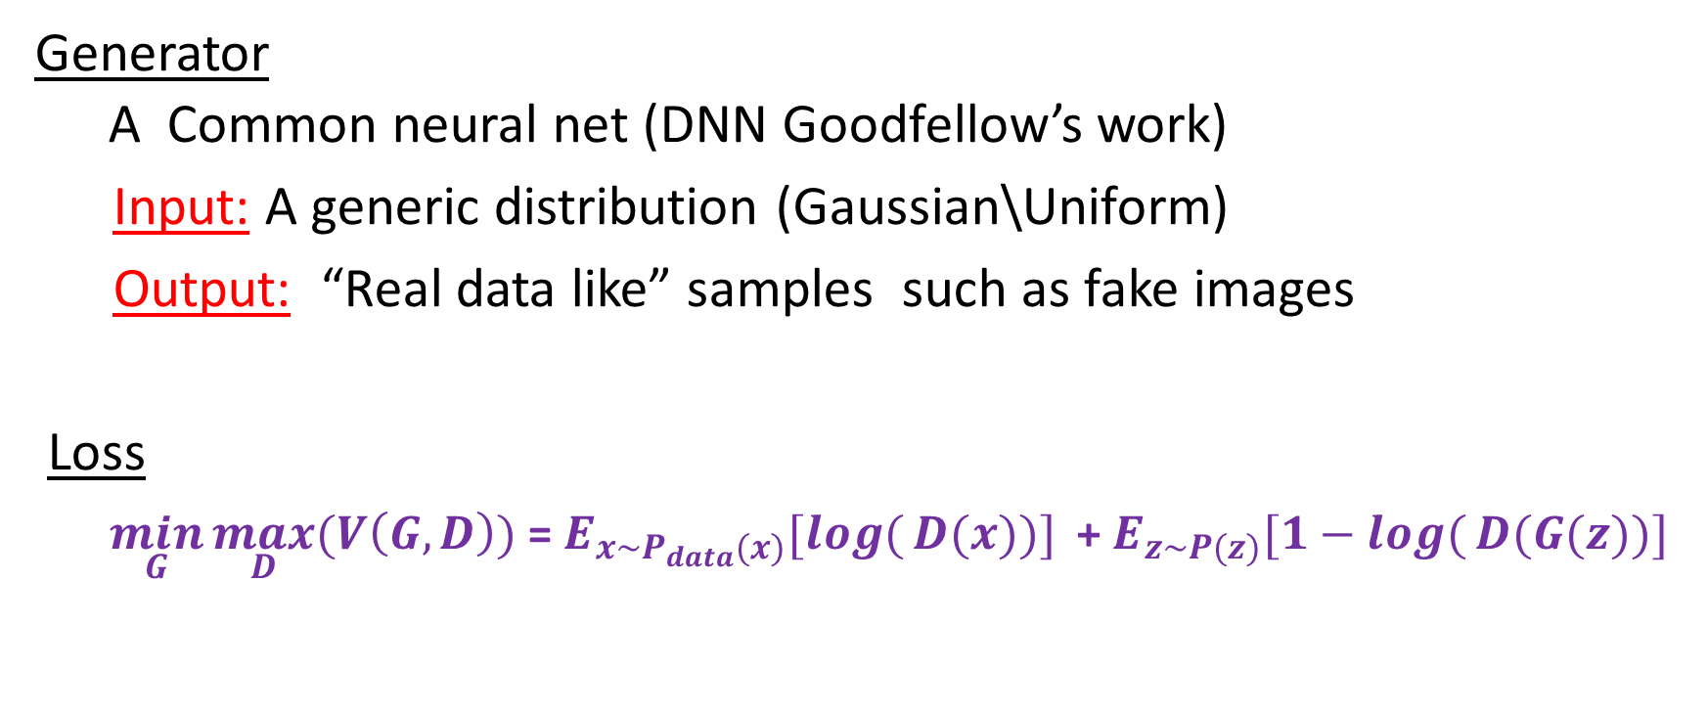
Goodfellow’s Network -GAN
Generator
A Common neural net (DNN Goodfellow’s work)
Input: A generic distribution (Gaussian\Uniform)
Output: “Real data like” samples such as fake images
Loss
$\min_{G}{\max_{D}{(V\left(G,D\right))}}$= $E_{x\sim P_{data}(x)}[log({D(x))}]$ + $E_{z\sim P(z)}[1−log({D(G(z))}]$

Slide 44

Jensen Shannon Divergence (JSD)
JSD($P_{r}$ || $P_{g}$) = 0.5*KL($P_{r}$ || $P_{A}$) +0.5*KL($P_{g}$ || $P_{A}$)
${ P}_{A}$ = $\frac{P_{r} +P_{g}}{2}$
This metrics works better than KL (it is symmetric ) but still it suffers from vanishing gradient issues and mode collapse of the generator.

Slide 45
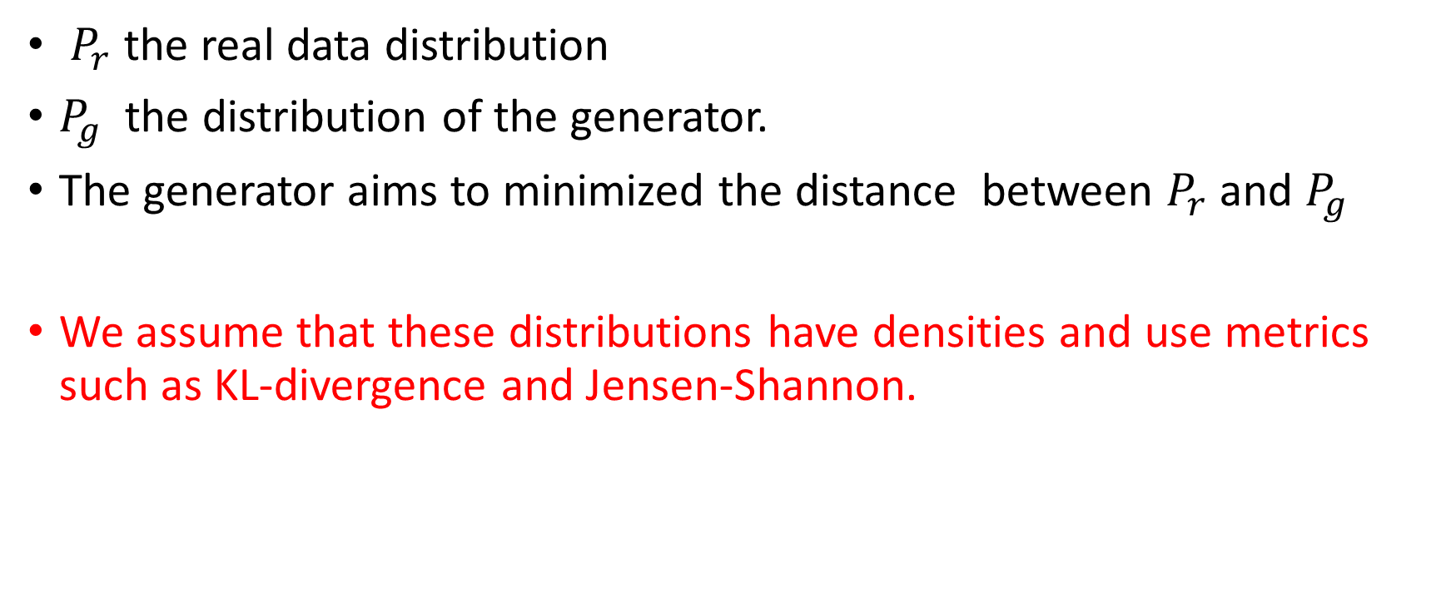
Training
$P_{r}$ the real data distribution
$P_{g}$ the distribution of the generator.
The generator aims to minimized the distance between $P_{r}$ and $P_{g}$
We assume that these distributions have densities and use metrics such as KL-divergence and Jensen-Shannon.

Slide 46
GAN –Advanced Architectures
DCGAN – Both generator and discriminator are CNN:
using batch normalization, no max pooling layers, in the disc, we replace fully connected layers by average pooling
CGAN – Supervised data where the inputs of both the discr & the generator contains the target
ACGAN –Similar to CGAN but a score is given for the class as well
Torch examples are here https://github.com/eriklindernoren/PyTorch-GAN/tree/master/implementations

Slide 47
Is GAN perfect?
A cool, innovative machine that acts well as a generative tool
But…. it has some failures..
It’s a male after all

Slide 48
Empirical problems in GAN
Parameters hardly converge , instead they tend to oscillate
Generator collapses which significantly reduces the generated samples variance
As the discriminator improves itself the gradient of the generator vanishes, and learning does not take place

Slide 49
KL Divergence issues
KL divergence diseases
There are domains where real data has high prob and generated data has small prob “mode dropping” . The outcome is high value of KL that guides the generator that this area is “wrong”
Vice versa: data has low probability to be real and likely to be generated. The score tends to minimum so no learning.

Slide 50
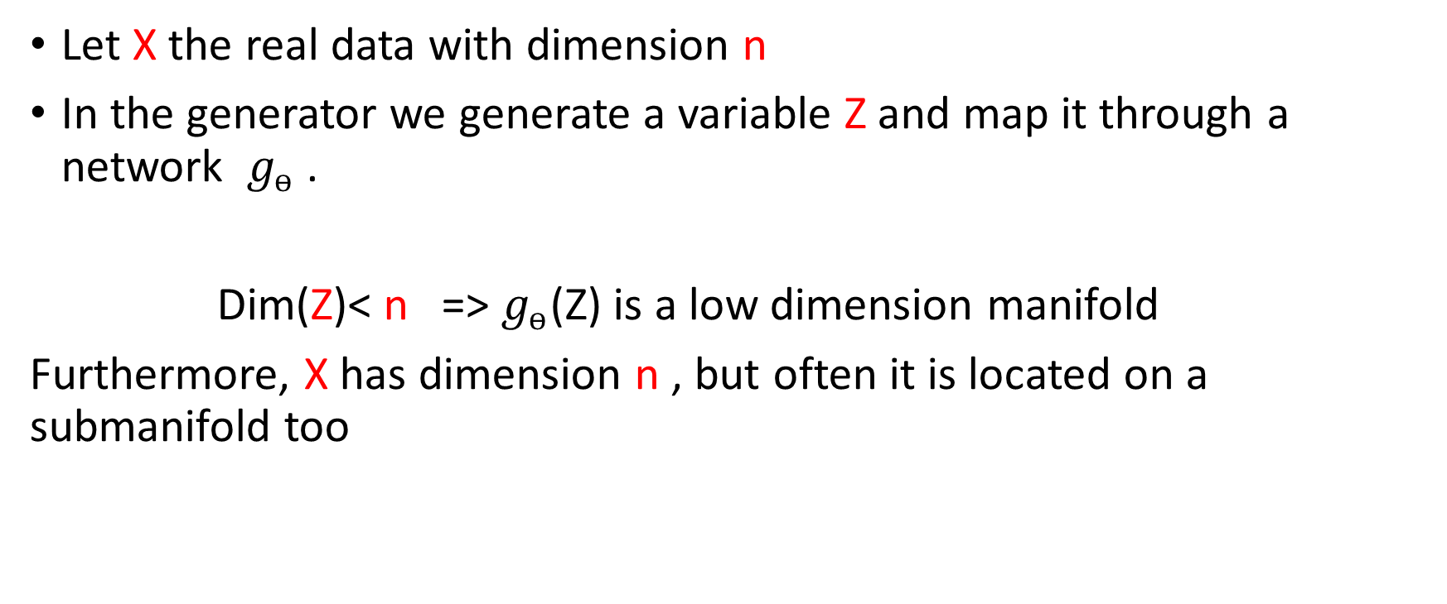
Strategic issues
Let X the real data with dimension n
In the generator we generate a variable Z and map it through a network $g_{ѳ}$ .
Dim(Z)< n => $g_{ѳ}$(Z) is a low dimension manifold
Furthermore, X has dimension n , but often it is located on a submanifold too

Slide 51
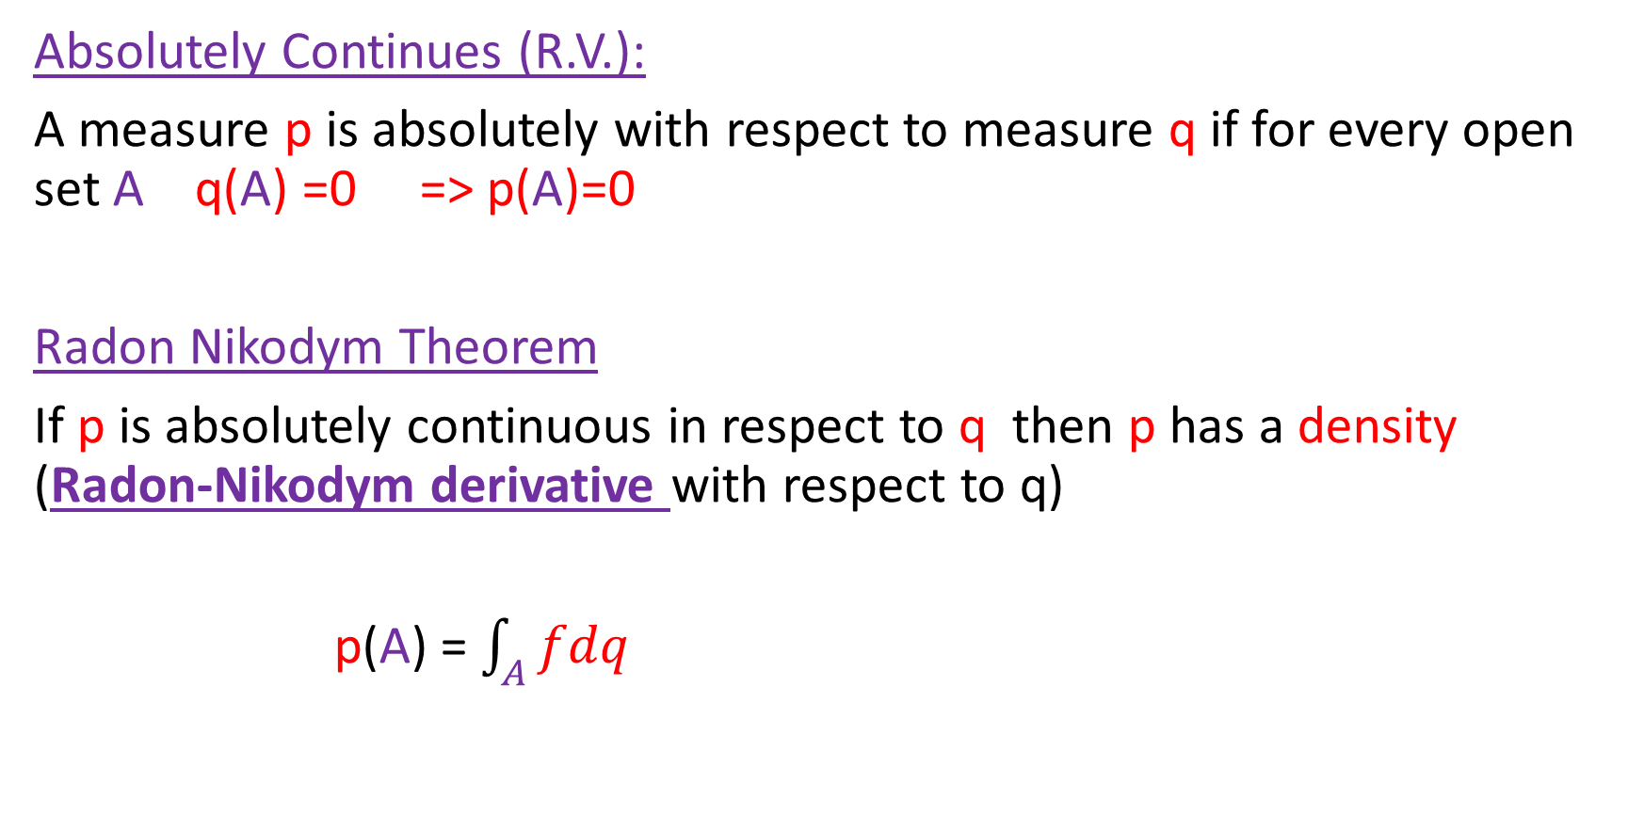
Nerds Only
Absolutely Continues (R.V.):
A measure p is absolutely with respect to measure q if for every open set A q(A) =0 => p(A)=0
Radon Nikodym Theorem
If p is absolutely continuous in respect to q then p has a density (Radon-Nikodym derivative with respect to q)
p(A) =$\int_{A}{fdq}$

Slide 52
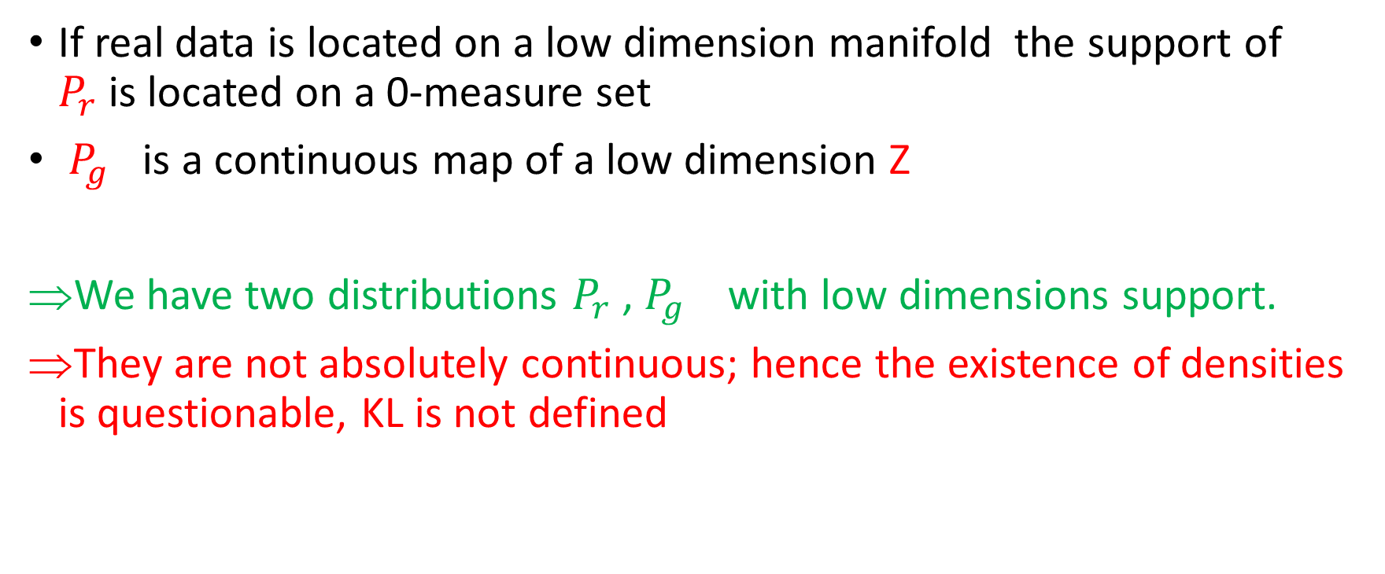
What does it mean?
If real data is located on a low dimension manifold the support of $P_{r}$is located on a 0-measure set
$P_{g}$ is a continuous map of a low dimension Z
We have two distributions $P_{r}$, $P_{g}$ with low dimensions support.
They are not absolutely continuous; hence the existence of densities is questionable, KL is not defined

Slide 53
Distributions rather Densities
Wasserstein GAN (Arjovsky, Bottou, Chintala)-four metrics
Total Variation (TV)
KL
JSD
Wasserstein1 (Earth Mover)

Slide 54
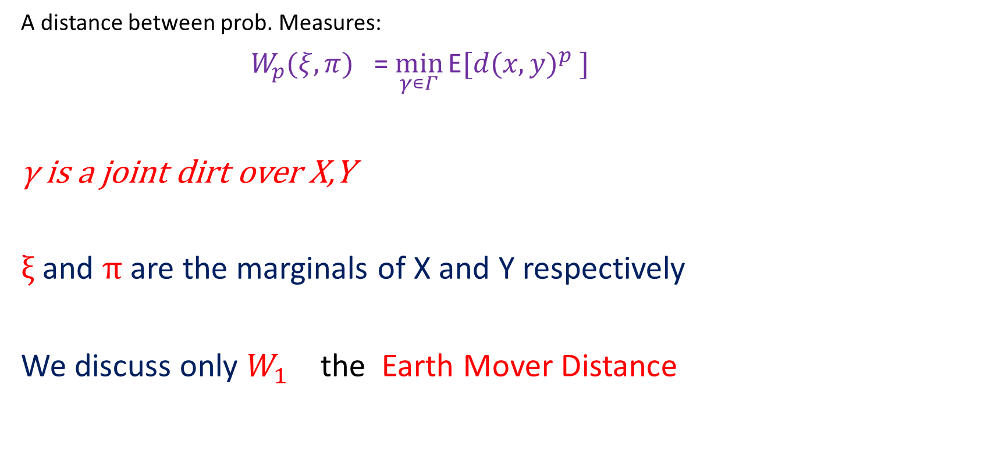
Wasserstein Distance
A distance between prob. Measures:
${ W}_{p}(ξ,π)$ =$\min_{γ∊Γ}{\text{E}{[d(x,y)}^{p} ]}$
γ is a joint dirt over X,Y
$ξ$ and $π$ are the marginals of X and Y respectively
We discuss only $W_{1 }$the Earth Mover Distance

Slide 55
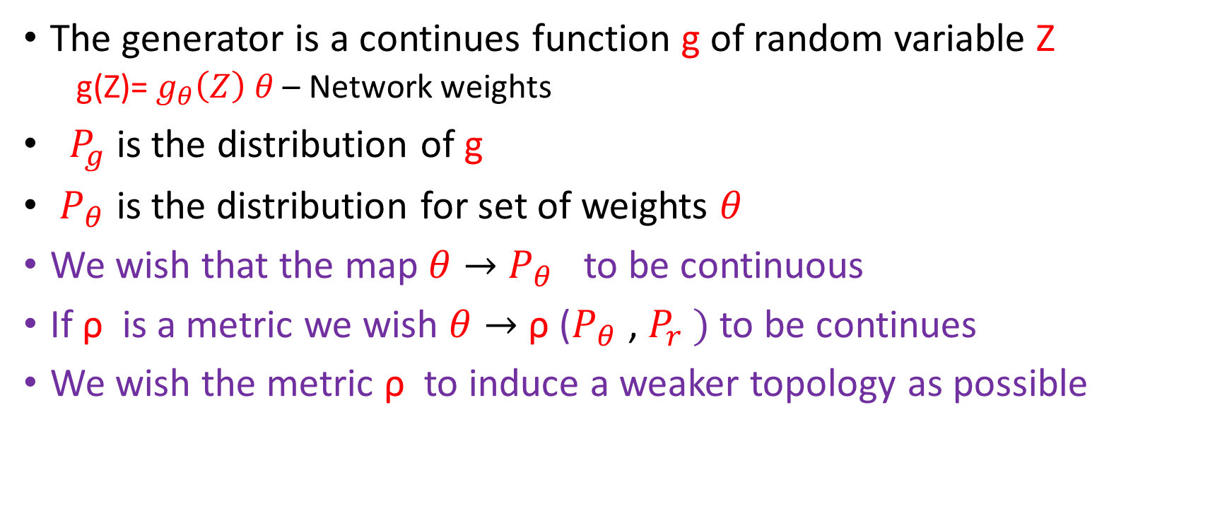
What do we compare?
The generator is a continues function g of random variable Z
g(Z)= $g_{θ}\left(Z\right) θ$ – Network weights
$P_{g}$ is the distribution of g
$P_{θ}$ is the distribution for set of weights $θ$
We wish that the map $θ→$ $P_{θ}$ to be continuous
If ρ is a metric we wish $θ→$ ρ ($P_{θ}$ , $P_{r} )$ to be continues
We wish the metric ρ to induce a weaker topology as possible

Slide 56
Is Wasserstein good?
Continuity?
Weak Topology?
Convenient for DL

Slide 57
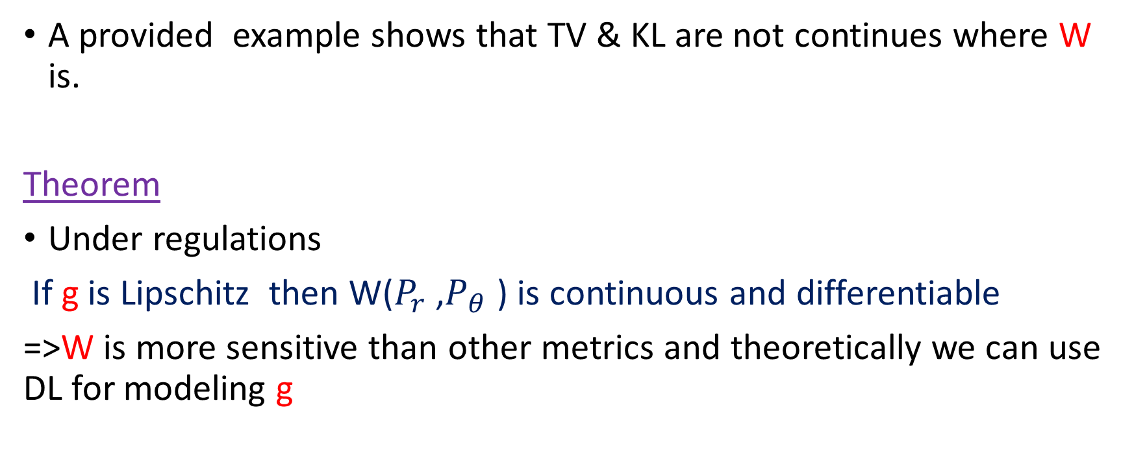
Continuity
A provided example shows that TV & KL are not continues where W is.
Theorem
Under regulations
If g is Lipschitz then W($P_{r}$,$P_{θ}$ ) is continuous and differentiable
=>W is more sensitive than other metrics and theoretically we can use DL for modeling g

Slide 58
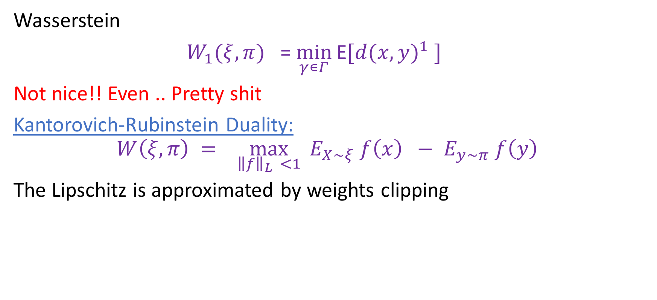
Convenient for DL
Wasserstein
${ W}_{1}(ξ,π)$ =$\min_{γ∊Γ}{\text{E}{[d(x,y)}^{1} ]}$
Not nice!! Even .. Pretty shit
Kantorovich-Rubinstein Duality:
$$W\left(ξ,π\right) = \max_{{\left\|f\right\|}_{L} <1}{{ E}_{X\sim ξ} f\left(x\right) − E_{y\sim π} f\left(y\right) }$$
The Lipschitz is approximated by weights clipping

Slide 59
Weak Convergence
Pinsker inequality implies that:
If KL divergence converges to 0 so does TV
For Nerds
TV induces a strong topology, over the space of distributions.
There exists a map from this space to the space of functionals over the bounded continuous functions (Riesz theorem).
We can obtain that Wasserstein is weaker than TV
=>Wasserstein induces a weak topology

Slide 60
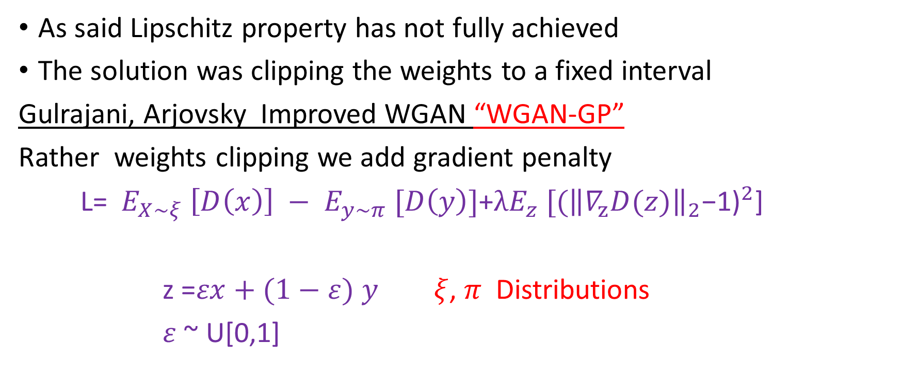
WGAN - GP
As said Lipschitz property has not fully achieved
The solution was clipping the weights to a fixed interval
Gulrajani, Arjovsky Improved WGAN “WGAN-GP”
Rather weights clipping we add gradient penalty
L= ${ E}_{X\sim ξ} \left[D\left(x\right)\right] − E_{y\sim π} [D\left(y\right)]$+$λE_{z}{{ [(\left\|∇_{z}D(z)\right\|}_{2}\text{−}\text{1}\text{)}}^{2}\text{]}$
z =$εx+(1−ε)$ $y$ $ξ$, $π$ Distributions
$ε$ ~ U[0,1]

Slide 61
GAN Summary
Generator – A deterministic function the maps distribution Q to distribution a vector in the space X “Real Data”
Discriminator – Receives vectors from space X and estimates whether
they are from distribution Q or dist. P
Loss- Function measures the distance between P & Q
We don’t need Markov chains
Work well with mini batches and have nice gradients
No inference during training
Handle “difficult “distributions (MC needs convenient dist.)

Slide 62
Now What?
SGLD - Finds posterior
Gan - Know to generate
Let’s do something nice together

Slide 63
Adversarial Posterior Distillation (APD)
Wang Vicol Locuas 2018

Slide 64
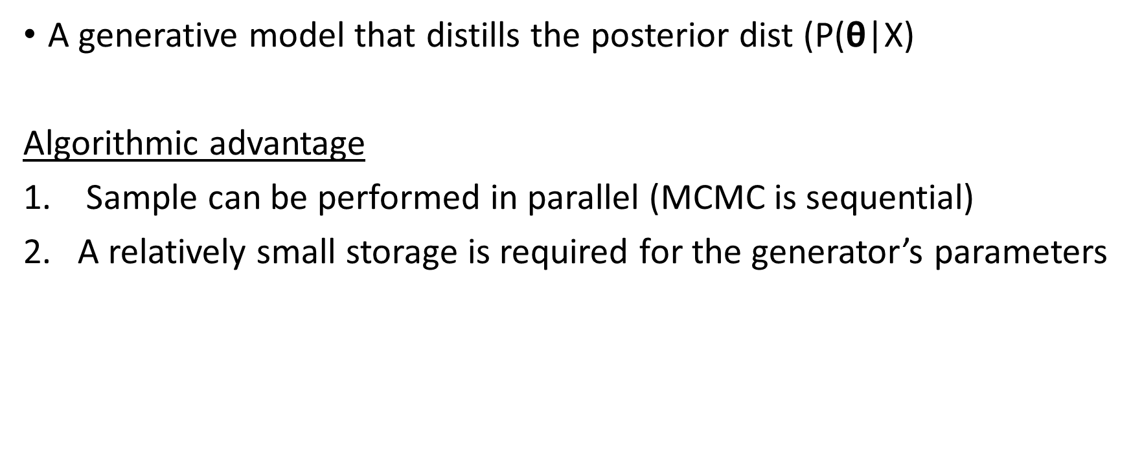
Adversarial Posterior Distillation (APD)
A generative model that distills the posterior dist (P($\text{θ}$|X)
Algorithmic advantage
Sample can be performed in parallel (MCMC is sequential)
A relatively small storage is required for the generator’s parameters

Slide 65

APD –Offline
SGLD: Sample a series of weights: ${\left\{{\text{θ}}_{t}\right\}}_{t=1}^{T}$
WGAN-GP optimizing where ${\left\{{\text{θ}}_{t}\right\}}_{t=1}^{T}$ is the “real data”

Slide 66
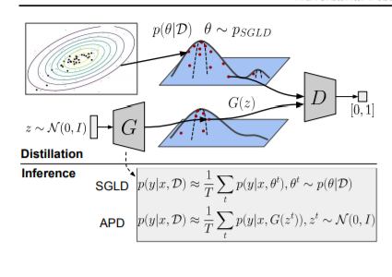

Slide 67
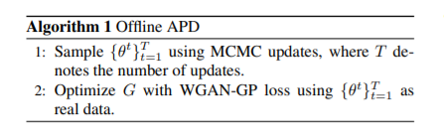

Slide 68
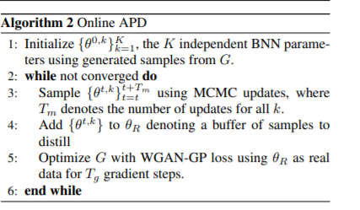

Slide 69
“Wow we are cool” part

Slide 70
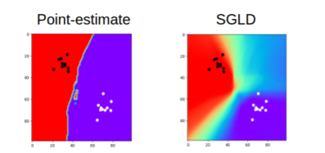

Slide 71

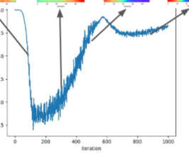

Slide 72
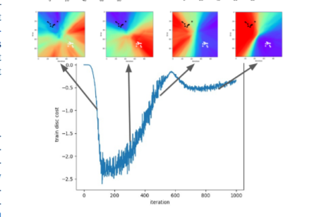

Slide 73
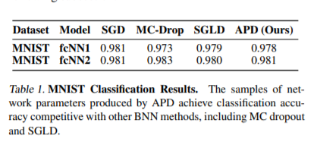

Slide 74
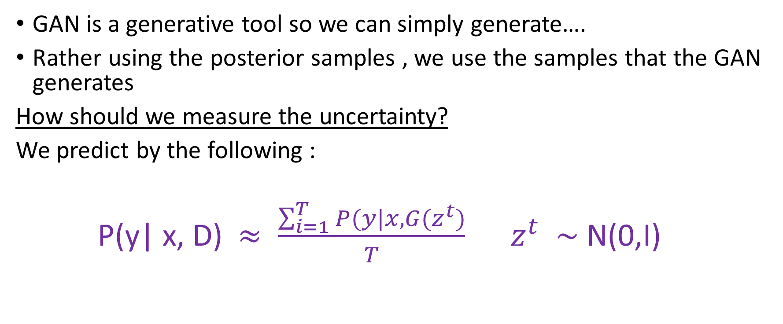
Post Training
GAN is a generative tool so we can simply generate….
Rather using the posterior samples , we use the samples that the GAN generates
How should we measure the uncertainty?
We predict by the following :
P(y| x, D) $≈ \frac{\sum_{i=1}^{T}{P(y|x,G(z^{t})}}{T}$ $z^{t}$ $\sim$ N(0,$\text{I}$)

Slide 75
Some outcomes
APD can retain SGLD characteristics:
Anomaly detection
Active Learning
APD reduces the storage cost of SGLD (or any other MCMC)
WGAN-GP works better than Wasserstein or the original GAN

Slide 76
That’s All
THANKS!!!

Slide 77
http://www.quretec.com/u/vilo/edu/2003-04/DM_seminar_2003_II/Bayes/lampinen01bayesian.pdf
http://bayesiandeeplearning.org/2016/slides/nips16bayesdeep.pdf
https://pdfs.semanticscholar.org/b0f2/433c088591d265891231f1c22424047f1bc1.pdf?_ga=2.47068911.9935516.1543231280-34044526.1542095209
https://arxiv.org/pdf/1505.05424.pdf
https://henripal.github.io/blog/langevin -pytorch code
https://www.coursera.org/lecture/bayesian-methods-in-machine-learning/bayesian-neural-networks-HI8ta
https://pdfs.semanticscholar.org/49c6/c08709d3cbf4b58477375d7c04bcd4da4520.pdf
https://pdfs.semanticscholar.org/579d/308b610da58266dbfa3574ba9c234ff1da13.pdf
https://arxiv.org/pdf/1701.07875.pdf
https://arxiv.org/pdf/1704.00028.pdf
https://arxiv.org/pdf/1806.10317.pdf
https://arxiv.org/abs/1112.5745

Slide 78
https://www.ics.uci.edu/~welling/publications/papers/stoclangevin_v6.pdf
https://www.cs.ox.ac.uk/people/yarin.gal/website/thesis/thesis.pdf
http://arogozhnikov.github.io/2016/12/19/markov_chain_monte_carlo.html
https://theclevermachine.wordpress.com/2012/11/18/mcmc-hamiltonian-monte-carlo-a-k-a-hybrid-monte-carlo/
https://arxiv.org/pdf/1206.1901.pdf
https://pdfs.semanticscholar.org/49c6/c08709d3cbf4b58477375d7c04bcd4da4520.pdf
http://citeseerx.ist.psu.edu/viewdoc/download?doi=10.1.1.446.9306&rep=rep1&type=pdf
https://papers.nips.cc/paper/4329-practical-variational-inference-for-neural-networks.pdf
https://www.cs.toronto.edu/~graves/nips_2011.pdf
https://arxiv.org/pdf/1206.1901.pdf
https://danieltakeshi.github.io/2017/11/26/basics-of-bayesian-neural-networks/
https://www.math.wustl.edu/~sawyer/hmhandouts/MetropHastingsEtc.pdf
http://edwardlib.org/tutorials/bayesian-neural-network -code python
http://physics.gu.se/~frtbm/joomla/media/mydocs/LennartSjogren/kap6.pdf
https://www.ics.uci.edu/~welling/publications/papers/stoclangevin_v6.pdf
https://henripal.github.io/blog/langevin
https://arxiv.org/pdf/1701.04862.pdf
https://pdfs.semanticscholar.org/34dd/d8865569c2c32dec9bf7ffc817ff42faaa01.pdf
https://medium.com/@jonathan_hui/gan-why-it-is-so-hard-to-train-generative-advisory-networks-819a86b3750
https://www.ics.uci.edu/~welling/publications/papers/stoclangevin_v6.pdfb

Slide 79
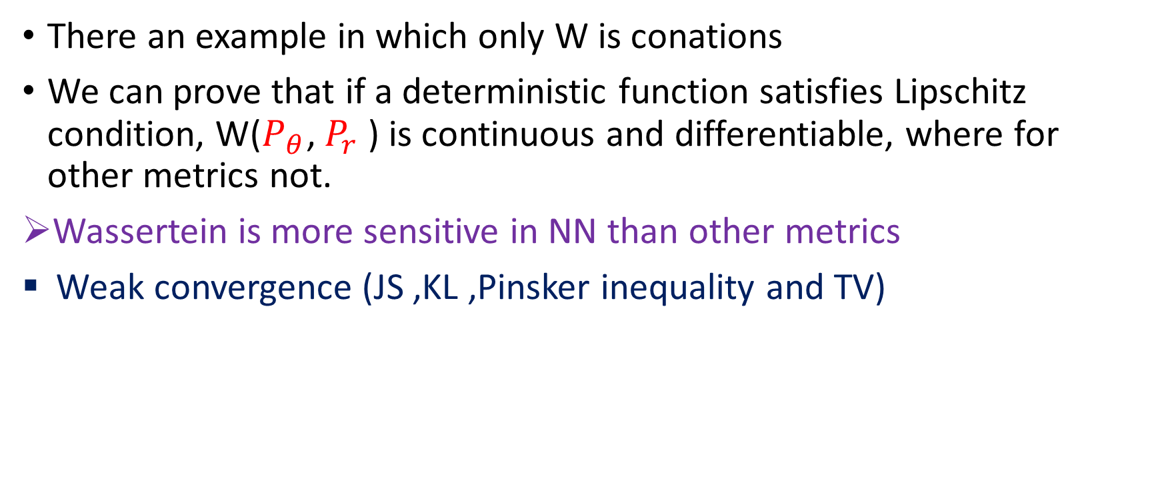
Wasserstein Gan
There an example in which only W is conations
We can prove that if a deterministic function satisfies Lipschitz condition, W($P_{θ}$, $P_{r}$ ) is continuous and differentiable, where for other metrics not.
Wassertein is more sensitive in NN than other metrics
Weak convergence (JS ,KL ,Pinsker inequality and TV)

Slide 80
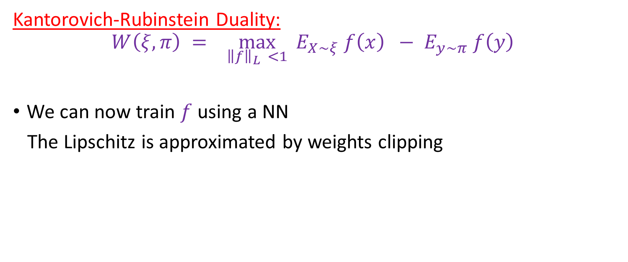
Can we make it convenient?
Kantorovich-Rubinstein Duality:
$$W\left(ξ,π\right) = \max_{{\left\|f\right\|}_{L} <1}{{ E}_{X\sim ξ} f\left(x\right) − E_{y\sim π} f\left(y\right) }$$
We can now train $f$ using a NN
The Lipschitz is approximated by weights clipping

